Slide 1

Chapter 15
Transmission
Control
Protocol
(TCP)
TCP/IP Protocol Suite
Copyright © The McGraw-Hill Companies, Inc. Permission required for reproduction or display.

Slide 2

OBJECTIVES:
To introduce TCP as a protocol that provides reliable stream delivery service.
To define TCP features and compare them with UDP features.
To define the format of a TCP segment and its fields.
To show how TCP provides a connection-oriented service, and show the segments exchanged during connection establishment and connection termination phases.
To discuss the state transition diagram for TCP and discuss some scenarios.
To introduce windows in TCP that are used for flow and error control.
TCP/IP Protocol Suite

Slide 3

OBJECTIVES (continued):
To discuss how TCP implements flow control in which the receive window controls the size of the send window.
To discuss error control and FSMs used by TCP during the data transmission phase.
To discuss how TCP controls the congestion in the network using different strategies.
To list and explain the purpose of each timer in TCP.
To discuss options in TCP and show how TCP can provide selective acknowledgment using the SACK option.
To give a layout and a simplified pseudocode for the TCP package.
TCP/IP Protocol Suite

Slide 4
Chapter
Outline
15.1 TCP Services
15.2 TCP Features
15.3 Segment
15.4 A TCP Connection
15.5 State Transition Diagram
15.6 Windows in TCP
15.7 Flow Control
15.8 Error Control
15.9 Congestion Control
15.10 TCP Timers
15.11 Options
15.12 TCP Package
TCP/IP Protocol Suite

Slide 5
15-4 A TCP CONNECTION
TCP is connection-oriented. It establishes a virtual path between the source and destination. All of the segments belonging to a message are then sent over this virtual path. You may wonder how TCP, which uses the services of IP, a connectionless protocol, can be connection-oriented. The point is that a TCP connection is virtual, not physical. TCP operates at a higher level. TCP uses the services of IP to deliver individual segments to the receiver, but it controls the connection itself. If a segment is lost or corrupted, it is retransmitted.
TCP/IP Protocol Suite

Slide 6
Topics Discussed in the Section
Connection Establishment
Data Transfer
Connection Termination
Connection Reset
TCP/IP Protocol Suite

Slide 7
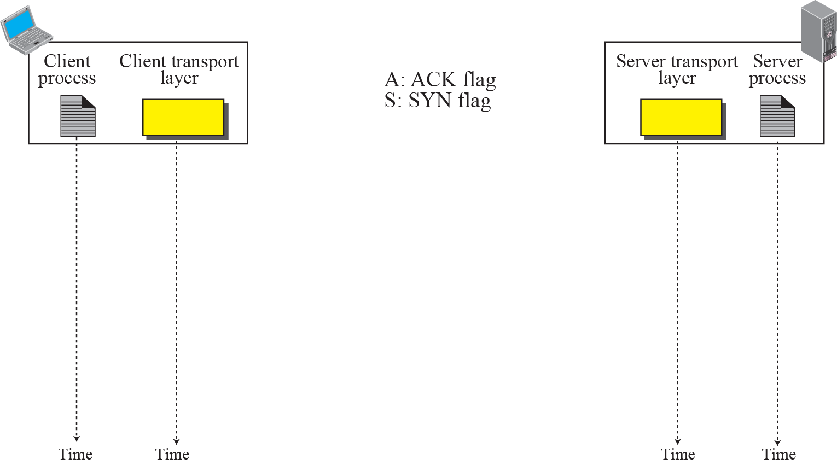
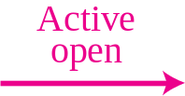
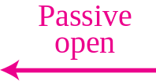
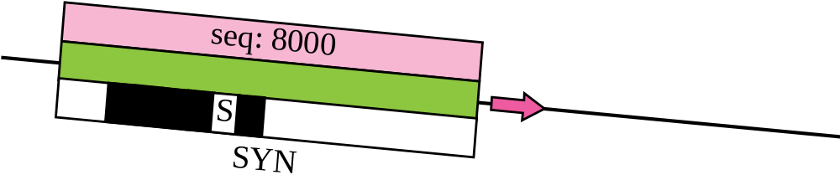
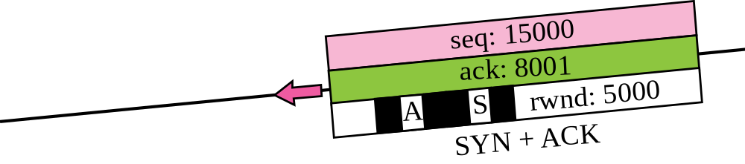
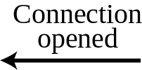
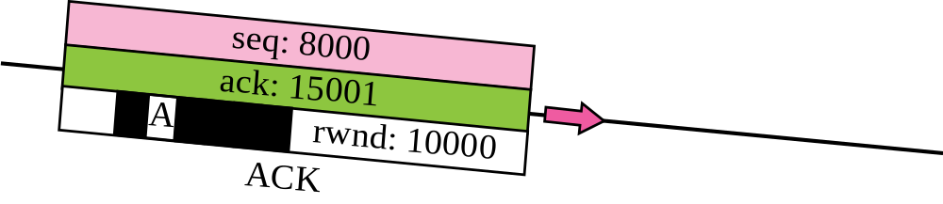

Figure 15.9 Connection establishment using three-way handshake
Means “no data” !
seq: 8001 if piggybacking
TCP/IP Protocol Suite

Slide 8

Note
A SYN segment cannot carry data, but it consumes one sequence number.
TCP/IP Protocol Suite

Slide 9
Note
A SYN + ACK segment cannot carry data, but does consume one
sequence number.
TCP/IP Protocol Suite

Slide 10
Note
An ACK segment, if carrying no data, consumes no sequence number.
TCP/IP Protocol Suite

Slide 11
End of TCP Connection Establishment Phase
TCP/IP Protocol Suite

